Slide 1
Iteration 3: ICS 499
Ans Khan, Muhammad Sohail, Abdul Hazari

Slide 2
Transaction for Non-Profit Organization

Slide 3
Iteration 3
-- Introduction, Scope, Requirements, Goals
- Use case Diagram, Class Diagram and Sequence Diagram
- The UI for the new code (demo of working code)
- Project plan
- Project log

Slide 4
Introduction
The system concerns with an application that does transaction management for any non-profit organisation, that gets funding from individuals.
Any non-profit organisation can be chosen and money can transferred to that specific organisation or NGO.
Transaction can only be processed by adding or selecting credit cards

Slide 5
Scope
The donors or users will add their credit cards or paypal information, organisation name which they want to donate to and the amount to be donated so that they can make the transaction to the organisation.
e organisation.

Slide 6
Software Development Methodologies
We will be using Java in the eclipse environment for back-end part of it, to develop this software and its functionalities.
A GUI will be created in which all the functionalities will be implemented, HTML is going to be used for the front end part it.

Slide 7
Proposed System Functionalities
The system will contain these functionalities:
Sign up and Sign in.
Pick an organization of their choice.
Amount of money they want to donate.
Choose the Payment Method.
Make the payment.
Get the confirmation after making the payment.

Slide 8
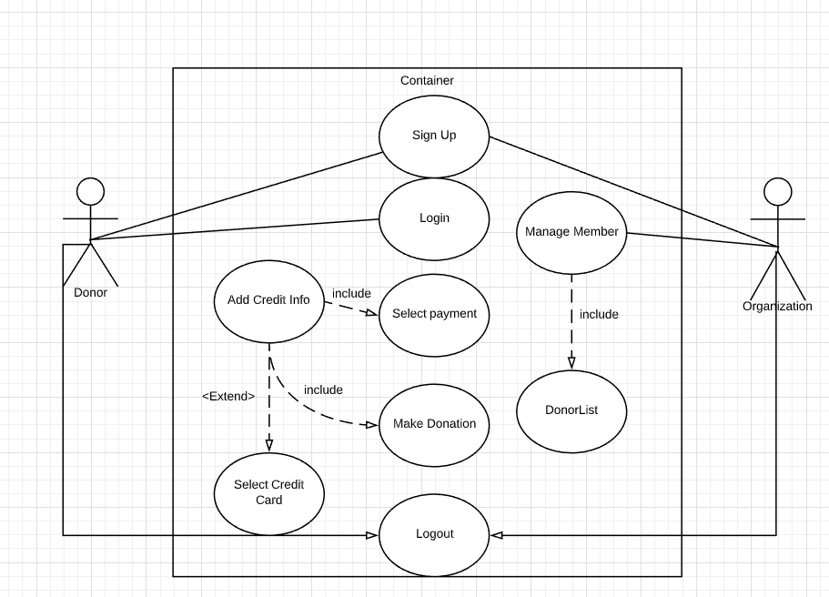
Use Cases

Slide 9
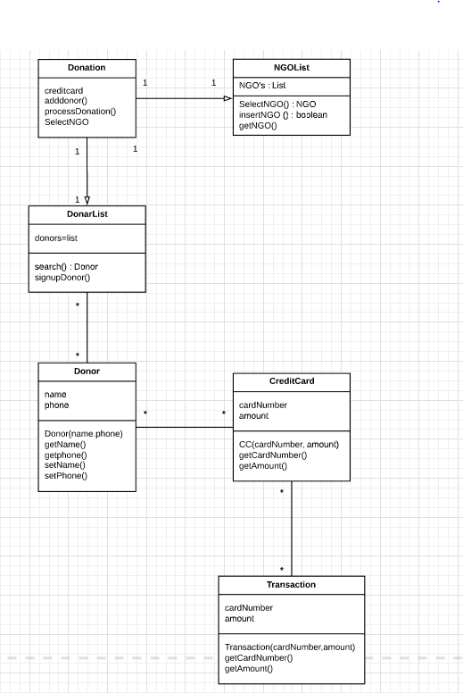
Class Diagram

Slide 10
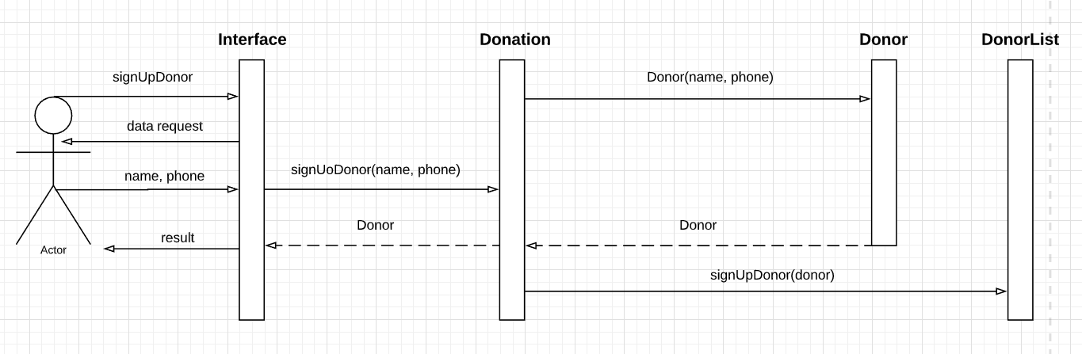
Sequence Diagram: Donor Sign-up

Slide 11
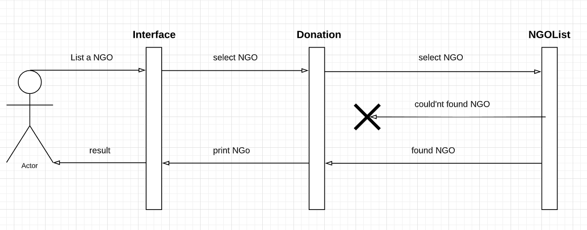
Sequence Diagram: List a NGO

Slide 12
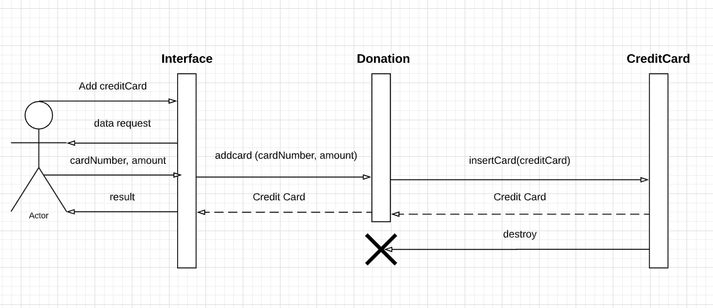
Sequence Diagram: Add Credit Card

Slide 13
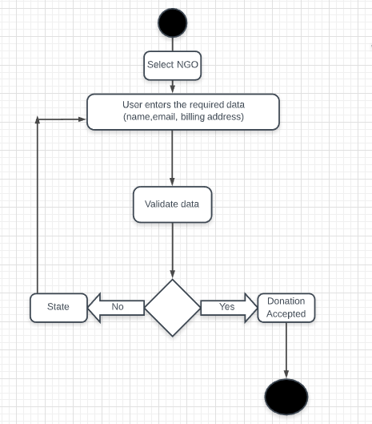
Activity Diagram

Slide 14
Project Plan
We will be working on the “Add Credit card” and Selecting NGO functionality.
We have to work on the Login functionality. Have to merge the back end and front end functionality.
Working on the user friendly display for the website when the user hits the “Donate Now” button.
Will deploy it on AWS Cloud Maybe!!
Work on final project report.

Slide 15
Project Log
09/14/2019 | Met the first time and worked on what we will be doing for the project.
09/15/2019 | Assigned the project duties to what each person will be doing.
09/27/2019 | Worked on sequence diagrams.
10/03/2019 | Worked on the front end code and back end (User Interface)
10/08/2019 | Worked on making the iteration.
10/22/2019 | Worked on the front end
11/2/2019 | Added functionalities to the front end.

Slide 16
Github
https://github.com/anskhan24/ICS-499-Project

